Slide 1

CAFÉ HARMONY PRESENTATION
Team Lyra

Slide 2
Problem
Product performance by GENDER.
Customer spending profiles.
Stock management inefficiencies.
Employee performance gaps.
Revenue produced from locations

Slide 3
Using the Pareto Principle Also known as the 80/20 rule analysis, to identify and focus on the following items:​
The most significant contributing product for the majority of sales​
Menu items that are performing best across different locations. ​
Customers who have a profile that tends to spend the most(age, gender, or preferred product).​
How can the café improve its stock management to avoid running out of popular items while also reducing overstock?​
Location or employee performance issues that require attention​

Slide 4
The Pareto Principle
With this approach, we aim to identify the top 20% of stock, employees, and customers that contribute to 80% of Café Harmony’s revenue. By focusing on this critical segment, we can extract key insights from the data and use them to generate intelligent business recommendations.
While we still consider the overall trends in the data, we pay particular attention to the consistent outliers that can disproportionately influence revenue performance. Although the 20/80 ratio is not a fixed rule, our goal is to highlight the minority of data points that drive value and minimize the impact of the majority that may contribute to losses.

Slide 5
Data Cleaning Techniques
Use of conditional formatting to detect duplicates and removing duplicate IDS
Removing blanks in the data to ensure there are no inconsistencies in the data
Changing data into the correct formats from General to Number or Date
Sorting data in alphabetical order in terms of the table’s unique IDS.
Categorising data for better representation such as age(Youth, Adult, etc) or location into urban and rural
Use of advanced formular such as IFS, XLOOKUP and VLOOKUP to categorise data

Slide 6
Data Analytics Tools Used
Excel
Pivot Tables
Pivot Charts
Slicers
Timeline

Slide 7
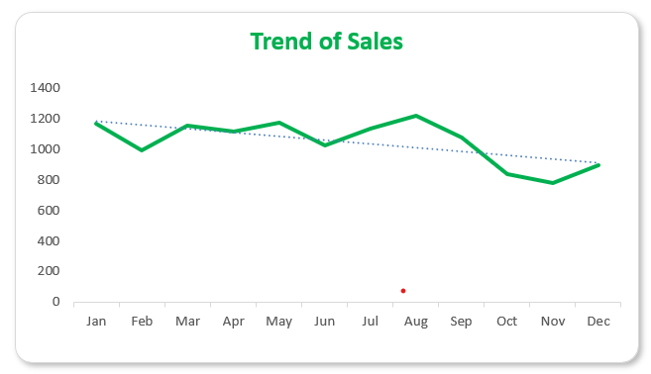
Trend of sale over the years
The chart portrays that sales remained relatively stable throughout the year, generally ranging between 700 and 1,000.
Modest peaks occurred in April and July, indicating stronger performance, while slight declines were observed in February, October, and December.
Overall, while sales were consistent, the trend suggests a gradual decline toward year-end. This highlights the need to explore new strategies to sustain growth and prevent further decreases.

Slide 8
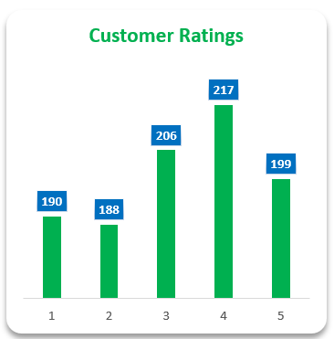
Overall business rating
The average rating of 3.05 is above average, suggesting that overall, the products have a positive impact on customer satisfaction.
Although the average rating was great the general customer comments showed that the products could be better

Slide 9
Which menu items are performing the best across different locations?

Slide 10
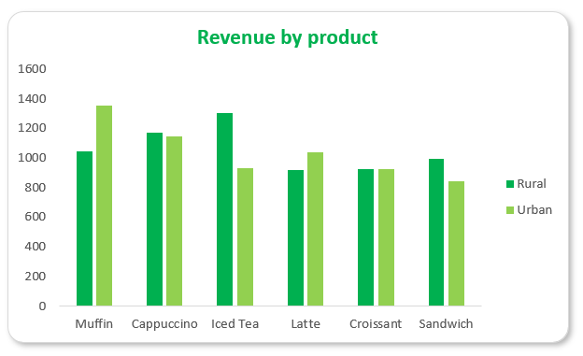
1. Which top-selling menu product generate the most revenue?
Muffins generates the highest revenue overall but thrives in Urban areas as airport and Uptown.
Iced tea has the best overall appeal to Suburbs and downtown.
The margin of a product’s consumption is generally low in the respective locations.
In general Sandwiches have the lowest overall revenue

Slide 11
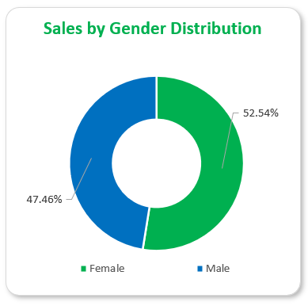
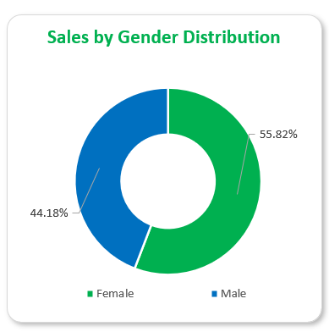
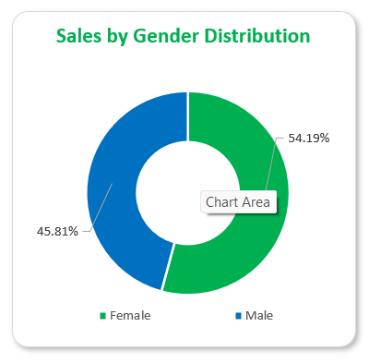
2. What is the customer profile that tends to spend the most (age, gender, or preferred product)?
Female customers are the overall highest revenue on all sectors.
By all age groups and Locations, Female customers have had the highest overall count on revenue

Slide 12
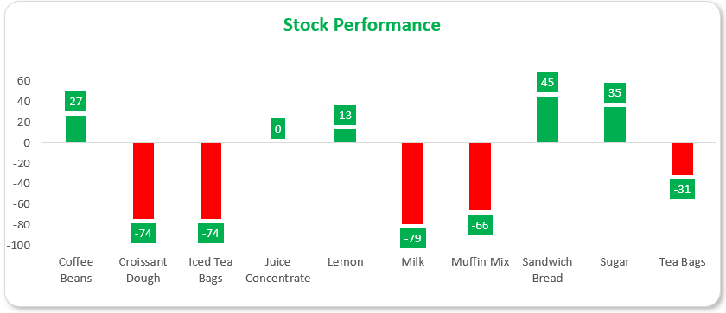
3. How can the café improve its stock management to avoid running out of popular items while also reducing overstock?
Overstocked Items: Positive metrics, such as coffee beans.
Understocked Items: Negative metrics, like milk.
Ideal Stock: Maintained at a 0 margin, exemplified by juice concentrate.
There is a significant stock imbalance in the café, with majority of the inventory not meeting the required standards leading to waste customer unfulfillment.

Slide 13
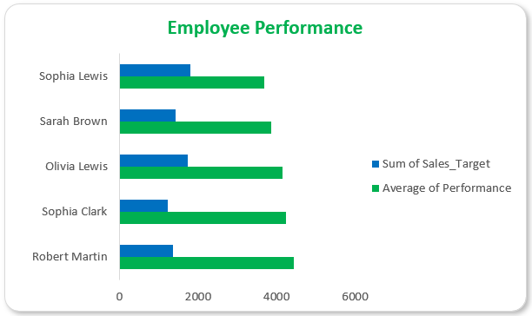
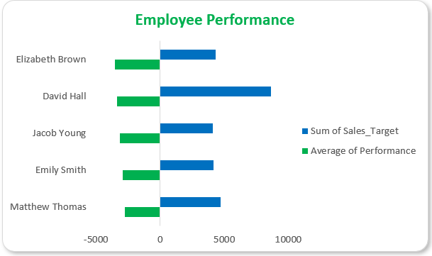
4. Are there any employee performance issues that require attention?
Table A (left) indicates that the average performance targets for the top 5 employees are less than half of their achievement, suggesting that expectations should be raised.
Table B (right) highlights the employees who are underperforming, not meeting the bare minimum.
This implies that the targets set are either unreasonably low for some employees or unrealistically high for others.

Slide 14
Business Recommendations

Slide 15
1. Optimize Menu & Inventory
Focus on demand
Double Down on Top Sellers:
Expand muffin flavors/options in Urban locations (airports, Uptown).
Promote Iced Tea combos in Suburbs/Downtown via signage or discounts.
Reduce Sandwich Waste:
Test smaller batches or revamp recipes to boost appeal of Sandwich and Croissant.
in numbers, the café should consider stock in
terms of demographic demand and supply.
Instead of focusing on the amount of inventory

Slide 16

2. Targeted Marketing
Leverage Female Customer Loyalty:
Launch loyalty programs or promotions (e.g., "Buy 5 muffins, get 1 free") to boost sales among our existing strong customer base.
Partner with women-centric events and communities to promote café products that cater to their preferences.
Encourage family menus to leverage our existing female customers in reaching out to potential male customers.

Slide 17
3. Improve Stock Efficiency
Adjust Orders:
Reduce coffee bean, sandwich bread and sugar purchases and reallocate budget to milk, croissant dough, Iced tea bags, and muffins mix.
Use Juice Concentrate’s "0 margin" model as a benchmark for other items inventory.
Tech Solution:
Developed and implemented dynamic inventory tracking with real-time low-stock alerts to ensure product availability.
Integrated a Point of Sale (POS) management system for accurate tracking of both sales and inventory.
Configured weekly automated stock alerts to enable timely replenishment and reduce stockouts.

Slide 18
4. Employee Performance
Raise Targets: Set higher but achievable goals for top performers
Training/Support: Address underperformers with coaching or role adjustments

Slide 19
5. Location-Specific Strategies
Suburban/Downtown: Highlight Iced Tea as a "local favorite" in rural marketing.
Urban Focus: Capitalize on muffin/Capuchino demand with grab-and-go options.

Slide 20
THANK YOU.
Café Harmony
Team Lyra

